Slide 1






Car4U – Car dealership website
Submitted By: Manav Sharma
Roll Number: 121922019
Course: BCA (Data Science), Semester VI
Guide: Mr. Tarun Sharma
Institute: Jagannath University, Rohini Sector 3
Live Link: https://car4uglobe.netlify.app

Slide 2
Introduction
Cars4U is a car dealership website designed to showcase cars online.
It offers a seamless interface for browsing, reviewing, and contacting the dealer
Created using front-end technologies like HTML, CSS, and JavaScript.
💡 Hosted online via Netlify for public access.
Goal: Build a modern dealership website accessible from any device.

Slide 3
Objective of the Project
🎯 To develop a real-world web application that:
Provides a platform for car dealerships to showcase vehicle listings.
Helps users explore cars, read reviews, and reach out for queries.
Demonstrates core web development skills using HTML, CSS, and JavaScript.
Increases dealership reach by creating a fully online presence.

Slide 4
Key Features
🧩 Main Features of Cars4U:
Homepage: Sleek UI with navigation and animated headings.
Car Section: Attractive cards displaying car models, specs, and pricing.
Review Section: Testimonials from happy customers.
Contact Page: Inquiry form with basic validation.
Responsive Menu: Hamburger menu for mobile screens.
Live Hosting: Accessible at car4uglobe.netlify.app

Slide 5
🛠️ Tools & Technologies
HTML5 – Page structure and elements
CSS3 – Styling, animations, Flexbox/Grid layout
JavaScript – Navigation toggle and interactivity
Font Awesome – Icons for cars, stars, and layout
Google Fonts – Stylish typography
Visual Studio Code – Primary code editor
Netlify – Deployed and hosted the website online

Slide 6
📐 System Design & Architecture
Static Front-End website (No backend yet)
Modular HTML sections:
index.html – Homepage • script.js – Menu toggle logic
style.css – Styling and responsiveness
Fully responsive layout built with CSS Flexbox and Grid
Pages:
Homepage • Cars Section
Contact Form • Review Section
Hosted on Netlify with continuous deployment support

Slide 7
System Requirements
💻 For Development:
Processor: i3 or higher
RAM: 4 GB+
OS: Windows / Linux
Editor: VS Code
Browser: Chrome, Firefox, Edge
📱 Mobile Support:
Fully responsive layout
Works on phones, tablets, and desktops
Mobile-friendly navigation (hamburger menu)
☁️ Hosting:
Hosted on Netlify (Free tier)

Slide 8
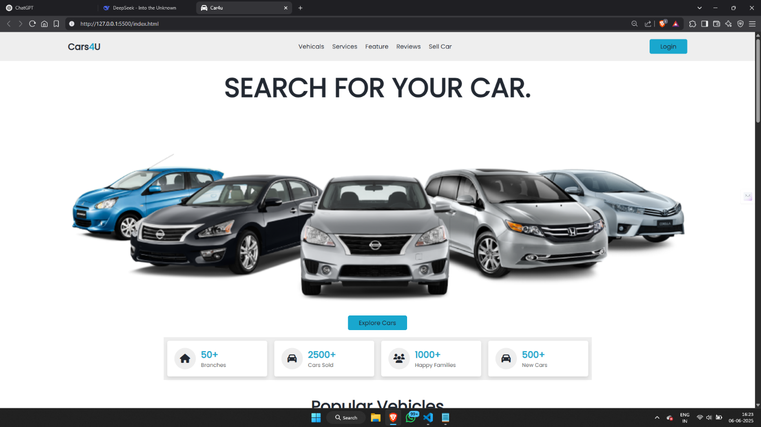
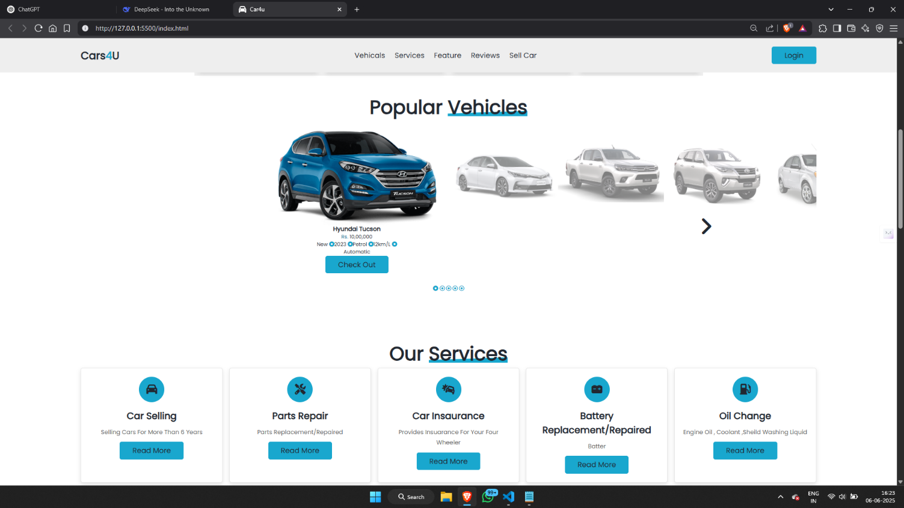
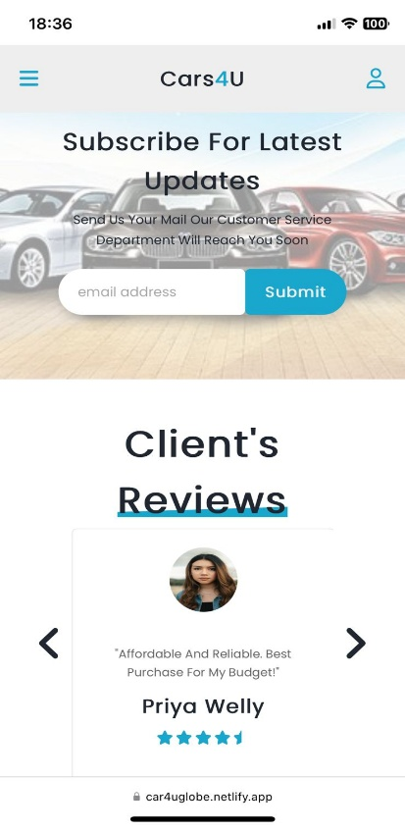
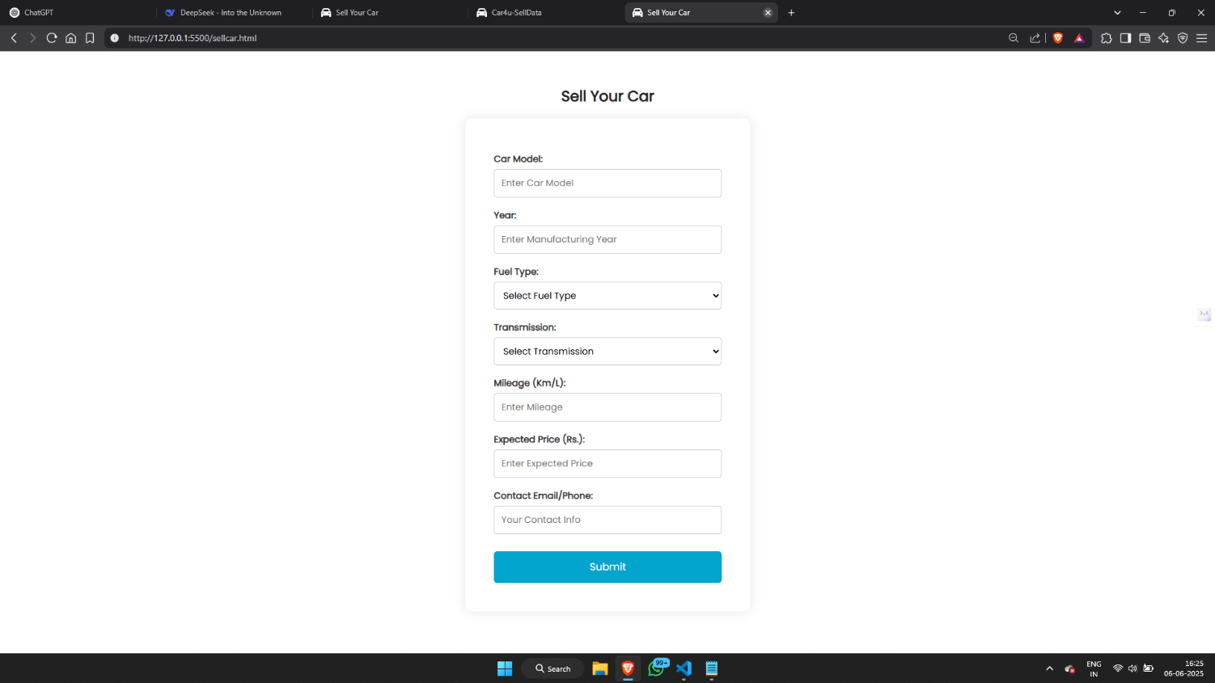
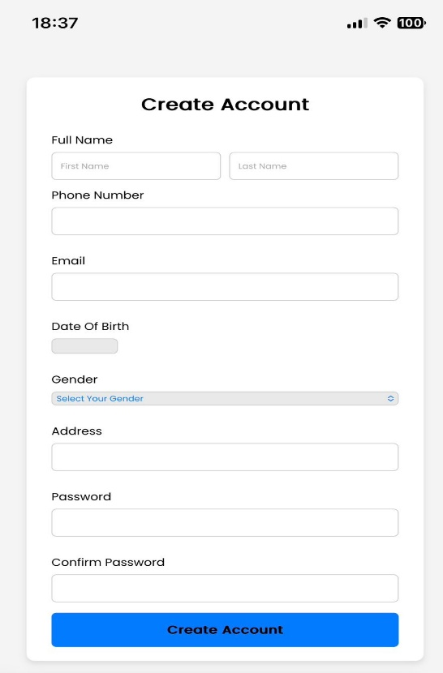
Screenshots of the Website

Slide 9
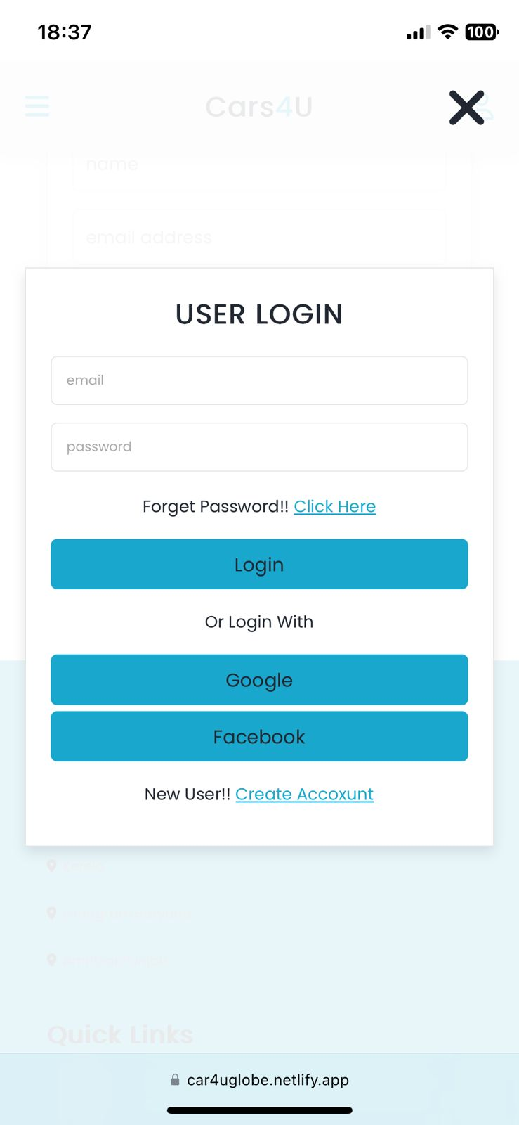
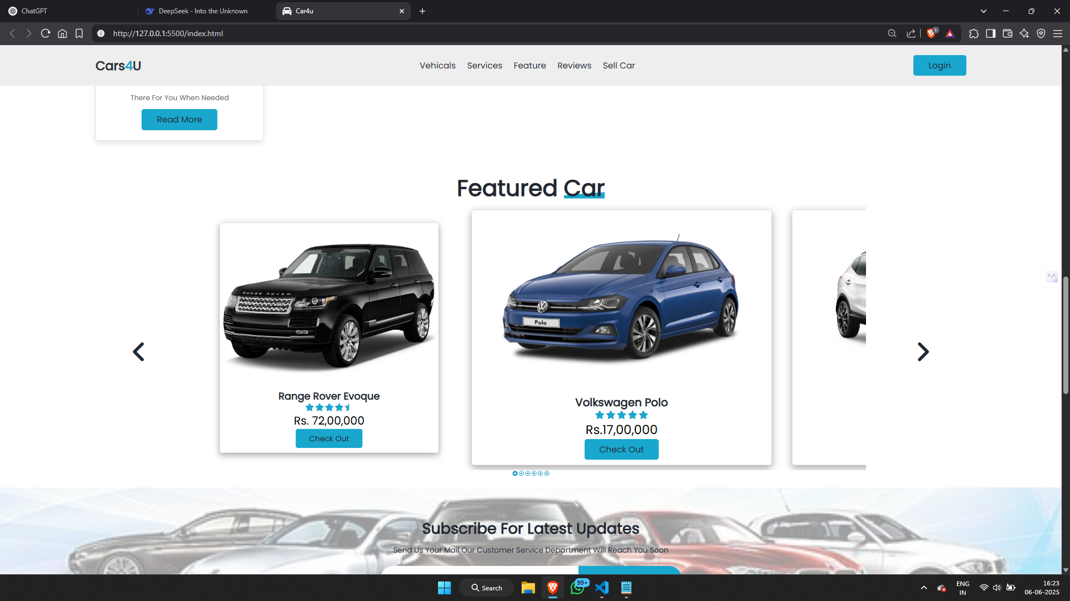
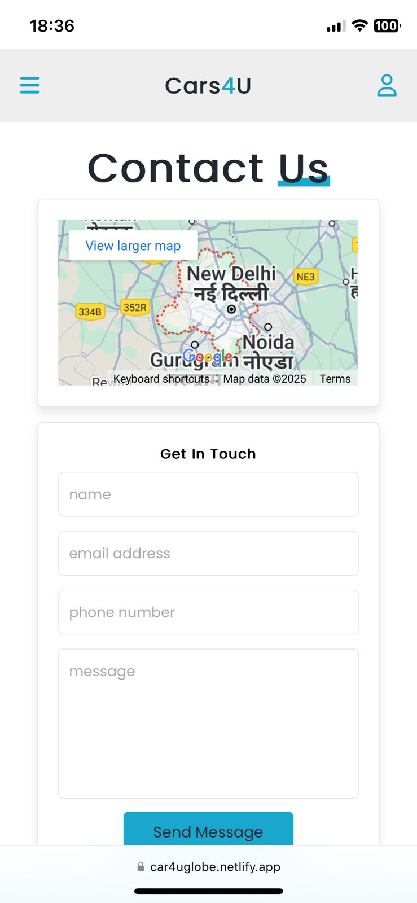

Slide 10
Conclusion & Future Scope
✅ Conclusion:
Cars4U is a modern, clean, and functional dealership website.
Hosted live at https://car4uglobe.netlify.app.
Demonstrates good understanding of HTML, CSS, JS, and responsive design.
Successfully deployed using Netlify for real-time web access.
🔮 Future Scope:
Integrate a backend using Node.js or PHP.
Make the contact form functional with email alerts or database storage.
Add admin panel to manage car listings.
Enable user registration and test drive bookings.
Add Google Maps integration for store locator.

